Slide 1
Cryptography
A Brief Overview
Alex Ying

Slide 2
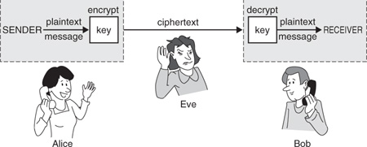
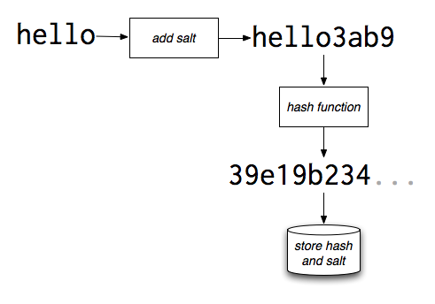
What is Cryptography?
Study techniques for secure communication
Across Space
Across Time
2

Slide 3
Where is Cryptography Used?
Secure Communication
Authentication
Digital Signatures
Random Number / Bit Generation
Cryptocurrency
3

Slide 4
Cryptographic Fundamentals
Plaintext – unencrypted information
Ciphertext – encrypted information
Encryption/Decryption – Conversion from plain to cipher text and vice versa
Cipher/Cryptosystem – an algorithm for encryption/decryption
Key – Secret information that secures the cryptosystem
4

Slide 5
Cryptographic Fundamentals
“the enemy knows the system” – Shannon
A cryptosystem should be secure even if everything about it is known (excluding the key) - Kerckhoff
Theory vs Practice
Implementation can introduce weaknesses
Side-channel attacks
5

Slide 6
Classical Cryptography (Pre-1976)
Symmetric schemes only
Operating on linguistic alphabets
6

Slide 7
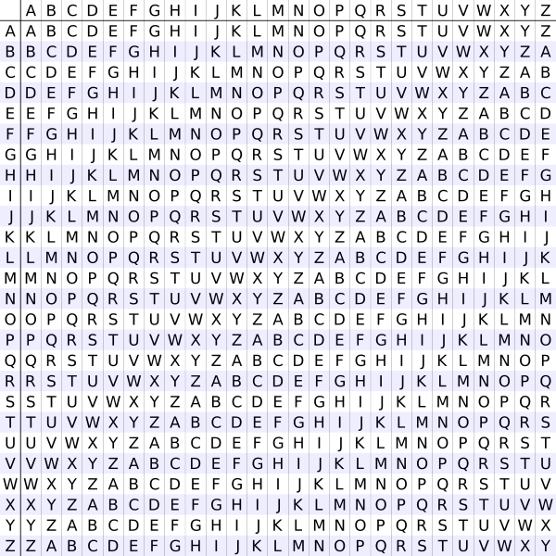
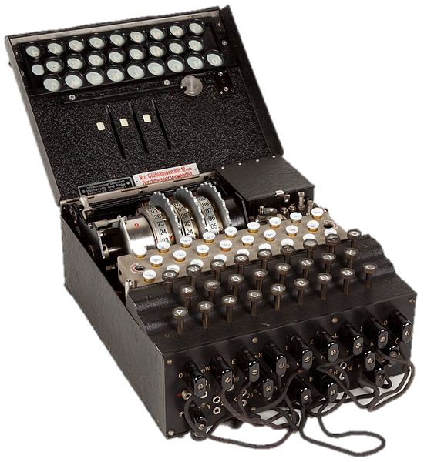
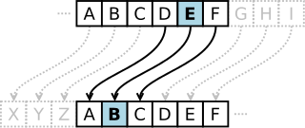
Classical Cryptography (Pre-1976)
Substitution Ciphers
Caesar Cipher
Vigenere Cipher
Enigma Machine
7

Slide 8
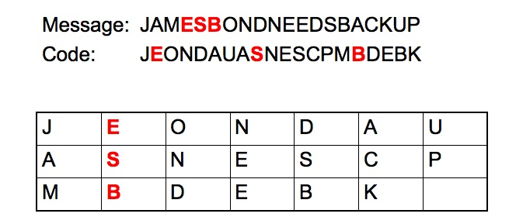
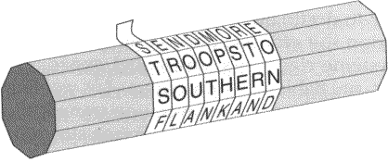
Classical Cryptography (Pre-1976)
Transposition Ciphers
8

Slide 9
Cryptographic Attacks
Ciphertext-Only
Known-Plaintext
Chosen-plain[or cipher]text
Adaptive Chosen-plain[or cipher]text
Related-Key
9

Slide 10
Attacks on Classical Systems
Substitution
Known-Plaintext and higher: relatively easily broken
Ciphertext-Only: frequency analysis
Transposition
Anagramming
Keys similar to the correct key produce large amounts of legible text
10

Slide 11
Modern Cryptography (Post-1976)
Operations on bits instead of alphabets
New Directions in Cryptography - Diffie/Hellman
Asymmetric cryptosystems
Public key cryptography
Built on one-way functions
Can create shared secrets for symmetric ciphers or can be used directly for encryption
11

Slide 12
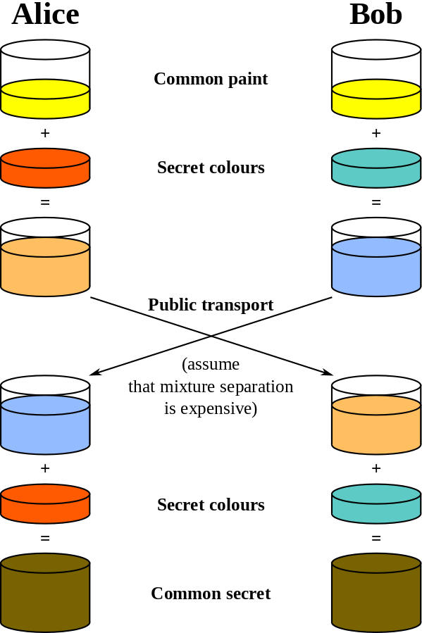
Diffie-Hellman Key Exchange
Creates a shared secret
Based on the Discrete Logarithm Problem
Exponential-time for brute-force solution
12

Slide 13
Public Key Encryption
Users have both a private and public key
Systems depends on operations that are easy with the private key, but difficult without it
RSA
Based on integer factorization
Exponential or sub-exponential complexity
Elliptic Curve Cryptography
Discrete logarithm problem on elliptic curves
Exponential complexity, smaller keys than RSA
13

Slide 14
Modern Symmetric Encryption
One-time Pad
Perfect secrecy provided a sufficiently random key
Key length must match message length
AES
Current NIST standard, block cipher
128, 192, and 256 bit keys
Multiple rounds of substitution and permutation
14

Slide 15
Hashing
Generates a deterministic “digest” of a message
Should be one-way (collisions are hard to find)
Small changes to input produce larges changes in output
Used in password verification and proof-of-work systems (block chains and cryptocurrency)
15

Slide 16
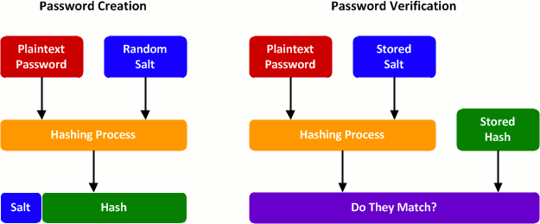
Password Verification
16

Slide 17
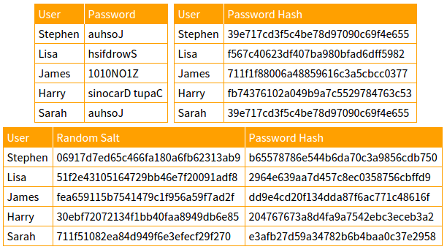
Password Verification
17

Slide 18
Modern Attacks
Theoretical cryptanalysis
Man-in-the-Middle (MITM) Attacks
Side-Channel Attacks
Timing
Power/Resource Monitoring
Shared cache
Modern computer security depends on more than just cryptographic methods
18

Slide 19
The Future of Cryptography
Increasing computing power
Quantum computing and quantum resistant cryptosystems
19

Slide 20
More Information
General: The Code Book (Simon Singh)
Cryptocurrency: 3Blue1Brown Video
Side-Channel Attacks:
Stealing Data From Computers Using Heat
Researchers Hack Air-Gapped Computer With Simple Cell Phone
Using the Sound of a Computer’s Fan to Steal Data
Malware Lets a Drone Steal Data by Watching a Computer’s Blinking LED
20

